Slide 1

DESIGN AND ANALYSIS OF ALGORITHMS (113939)
Dr. Owais Hussain

Slide 2
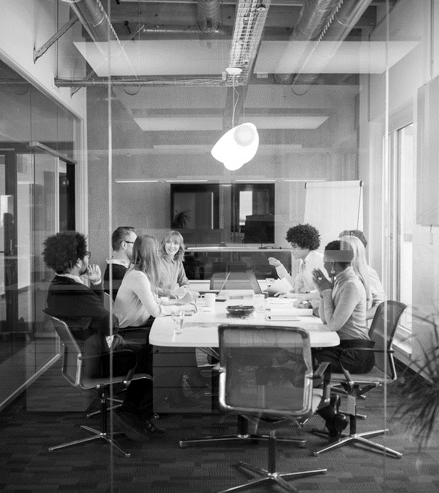
Agenda
Introduction
Algorithms, journey from Origin
Algorithms
Space and Time Complexity
Real life example

Slide 3
Sample 2
Introduction
The art of designing efficient algorithms is at the core of all computing functions in digital and real world.
From adding two numbers to colouring and upscaling a 50-year-old video.
From calculating distance from your home to the campus to calculating trajectories and impact of meteor showers.
In fact, they can help you win wars, like Alan Turing’s cracking of Enigma code.
Notes:
During World War II, the Allies' successful decryption of the German Enigma machine's encoded messages was a critical factor in their victory. The decryption effort, led by British mathematician Alan Turing, involved the use of sophisticated data structures and algorithms to crack the Enigma codes. By extracting vital intelligence from intercepted communications, the Allies gained a significant advantage in strategic decision-making, enabling them to thwart German military operations.

Slide 4
Sample 2
Algorithms, journey from Origin
Ancient Times:
Babylonians used arithmetic and algebra in 2000 BC.
Euclidean method was invented in 300 BC to find greatest common divisor of two numbers.
Chinese Remainder Theorem (3rd century AD) determined an unknown number from its remainders, when divided by several pairwise coprime numbers.

Slide 5
Sample 2
Algorithms, journey from Origin
Medieval Period:
Father of algorithms, Al-Khwarizmi introduced algorithms to the western world in 9th century. The word "algorithm" is derived from his name. He was the inventor of variables.
Persian and Arab Mathematicians kept developing algorithms for arithmetic operations for all practical purposes.
John Napier (1617) invented logarithms, which simplified calculations.
Leibniz (1670s) developed the binary number system.

Slide 6
Sample 2
Algorithms, journey from Origin
Industrial Period:
George Boole introduced Boolean algebra in 1850s.
All of the works so far were to solve existing practical problems.
But then came the mother of programming…

Slide 7
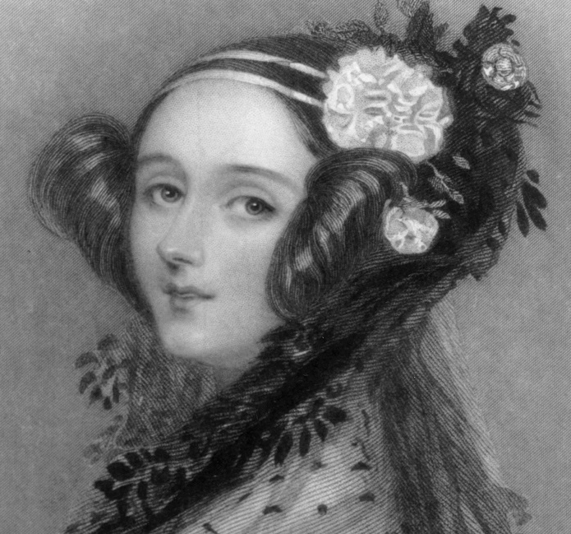
Sample 2
Algorithms, journey from Origin
The first thing you need when dealing with algorithms is a computer. Right?
Augusta Ada Lovelace didn’t need one to conceptualize “flyology”.
She proposed that for Charles Babbage’s Analytical engine, code can be used instead of numbers.
She wrote programs for the analytical engine to Add, subtract, multiply, divide, and even calculate Bernoulli numbers.
Notes:
Ada Lovelace, born to Lord Byron, the poet in 1815. Byron was a lowlife drunk man with low morals but wrote beautiful romantic poetry which inspired Ada.
The other traits came from her mother, a strictly religious mathematician. Ada learned algebra, geometry, physics, history, languages, geography, music, sewing, riding, shorthand, dance and more.
Flyology: a flying machine that could flap its wings.
Ada was bedridden for the most part of her teenage due to sicknesses. At the age of 18, she recovered and met Charles Babbage, the father of computer. She impressed him by demystifying his steam-based multiplication machine.

Slide 8
Sample 2
Algorithms, journey from Origin
Modern Period to Present:
Taking lead from Ada Lovelace’s programs, scientists rapidly built conceptual machines and algorithms to solve futuristic problems.
Alan Turing developed the concept of the Turing machine in 1930s. The modern name of Turning machine is “Computer”.
John von Neumann added concept of storage to computers in 1940s.
These contributions laid all foundations on which today’s computing world is built upon.

Slide 9
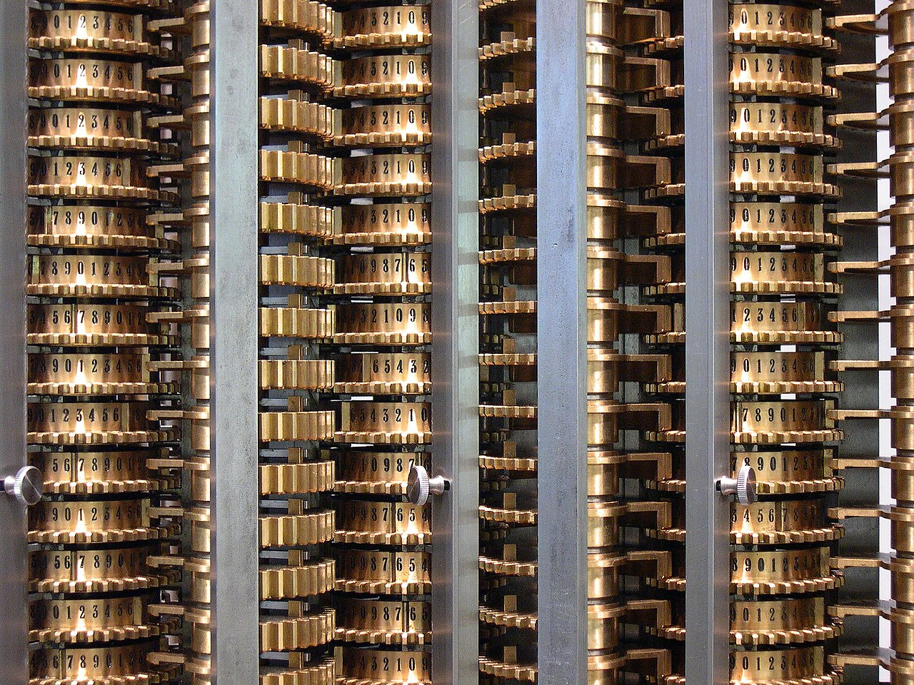
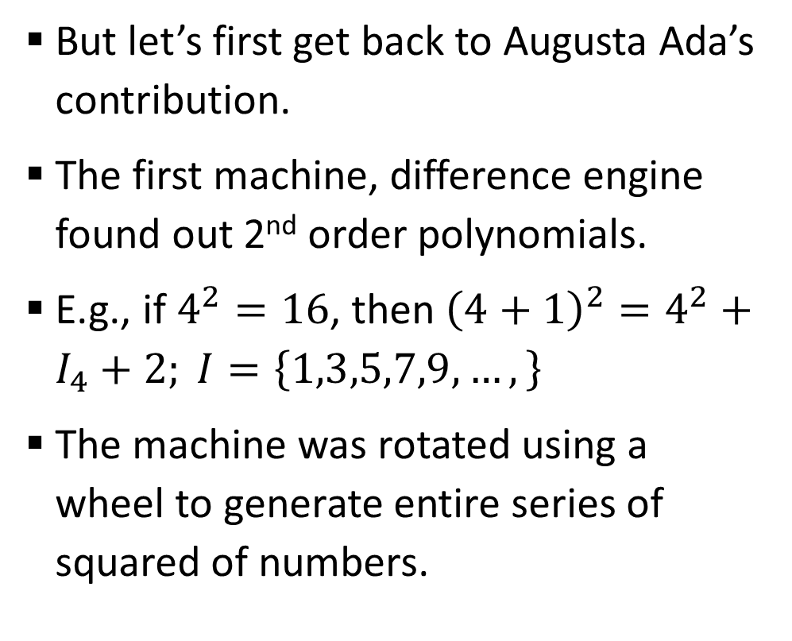
Sample 2
Algorithms, journey from Origin
But let’s first get back to Augusta Ada’s contribution.
The first machine, difference engine found out 2nd order polynomials.
E.g., if $4^{2}=16$, then ${\left(4+1\right)}^{2}=4^{2}+I_{4}+2; I=\left\{1,3,5,7,9,…,\right\}$
The machine was rotated using a wheel to generate entire series of squared of numbers.

Slide 10
Sample 2
Algorithms, journey from Origin
Next machine, Analytical engine was supposed to have a CPU (steam powered Mill), vertical columns of disks called Store (Memory), Printer, Variables (Punch cards) and Numbers (Punch cards).
Ada introduced the concept of Loops in this machine.
Second contribution was providing a series of punch cards which will tell what portion of machine to run, i.e., pass a function.
This way, the analytical function could make virtually any calculation making use of Ada’s programs. Thus, making it Turing complete.
Notes:
A machine is Turing complete if it is able to perform any Turing machine, i.e. it can compute any problem computable using Turing machine.

Slide 11
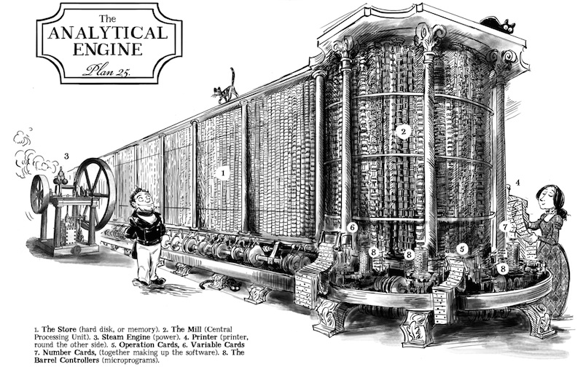
Sample 2

Slide 12
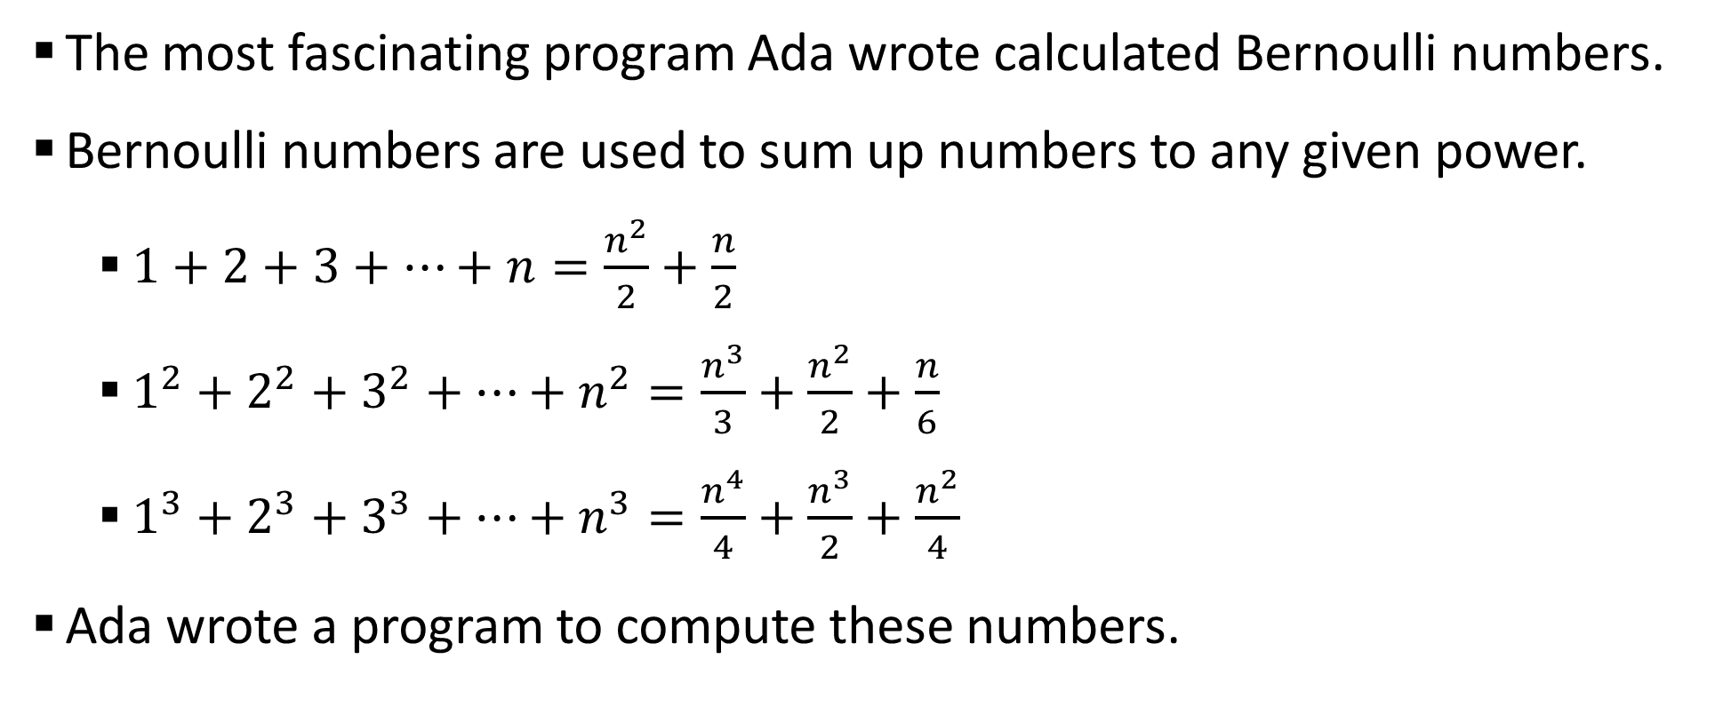
Sample 2
Algorithms, journey from Origin
The most fascinating program Ada wrote calculated Bernoulli numbers.
Bernoulli numbers are used to sum up numbers to any given power.
$1+2+3+…+n=\frac{n^{2}}{2}+\frac{n}{2}$
$1^{2}+2^{2}+3^{2}+…+n^{2}=\frac{n^{3}}{3}+\frac{n^{2}}{2}+\frac{n}{6}$
$1^{3}+2^{3}+3^{3}+…+n^{3}=\frac{n^{4}}{4}+\frac{n^{3}}{2}+\frac{n^{2}}{4}$
Ada wrote a program to compute these numbers.

Slide 13
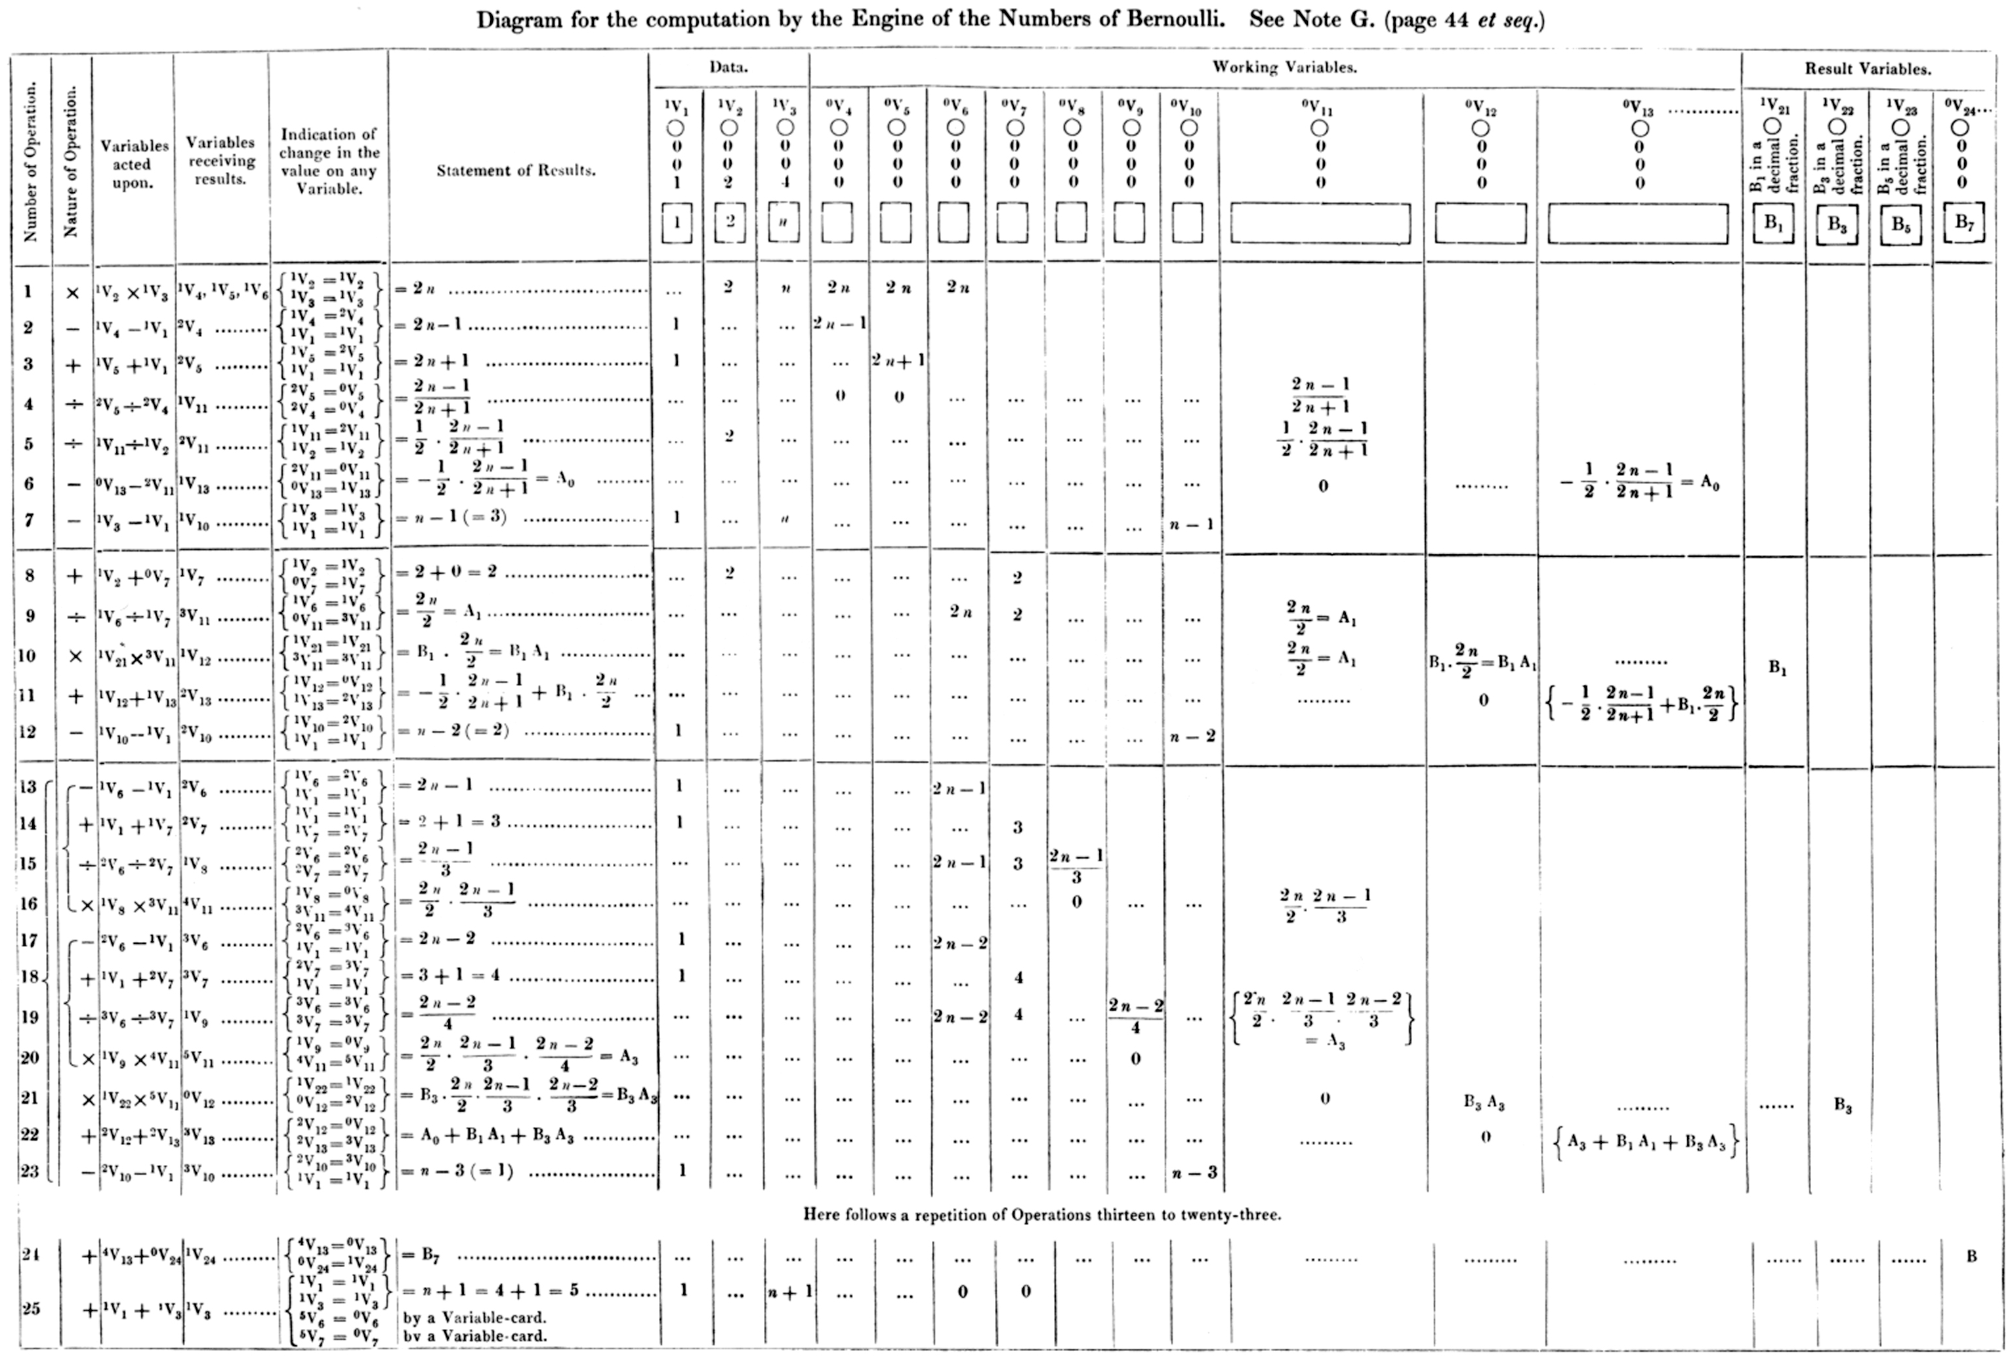

Sample 2

Slide 14
Sample 2
Algorithms, journey from Origin
Ada became countess of Lovelace; but she died at the age of 36 from cancer in 1852.
August Ada of Lovelace is sometimes not given credit she very well deserves in the history of computation, but she was the first person to write programs for a machine which did not physical exist.
130 years after her death, the Analytical machine was finally invented and one of its copies is Computer History Museum in California, USA.
Notes:
Recommended watch: https://www.youtube.com/watch?v=BlbQsKpq3Ak

Slide 15
Sample 2
Algorithms
An algorithm is a way to express logic. It can be in any language and use any symbols. It can be in plain English as well.
An algorithm can roughly be defined as a set of instructions with a clear meaning that can be performed within a finite amount of time to solve a problem. It takes some input, perform some operations on it and produces output.
An efficient algorithm solves a problem using low resources.

Slide 16
Sample 2
Algorithms
Standard definitions:
An algorithm is any well-defined computational procedure that takes some value, or a set of values as input and produces some value or set of values as output. [Thomas Cormen]
An algorithm is a sequence of unambiguous instructions for solving a problem, i.e., for obtaining a required output for any legitimate input in a finite amount of time. [Anany Levitin]
A finite sequence of rigorous instructions, typically used to solve a class of specific problems or to perform a computation. [Wikipedia]

Slide 17
Sample 2
Algorithms
An algorithm:
Can accept input.
Must produce output.
Works on known values only. E.g., imaginary numbers, infinities, are unacceptable.
Is composed of finite number of steps.
Takes finite time and finite memory to complete its operation.
Analyses: time efficiency, memory efficiency, power consumption, parallelization. But we primarily focus on time efficiency.

Slide 18
Sample 2
Algorithms
An algorithm:
Is independent of languages, hardware and software
Is conceptually designed
Requires domain knowledge
Is analyzed
Priori (analyze before building)
A Program:
Depends on language, hardware and software
Is implemented in a computer
Requires coding skills
Is tested
Posteriori (test after building)

Slide 19
Sample 2
Algorithms: Example
Find out whether a year is a leap year or not
Algorithm
Input a year
Divide it by 4 and 100
If the first remainder is 0 and second remainder is not 0, then the year is leap. Otherwise not.

Slide 20
Sample 2
Algorithms: Example
Now the correct version
Algorithm
Input a year
Divide it by 400
If the remainder is 0 then it’s a leap year.
Otherwise divide by 100
If the remainder is 0 then it is not a leap year.
Otherwise divide by 4
If the remainder is 0 then it is a leap year.
Otherwise, the number is not a leap year.
Notes:
What was wrong with the original algorithm?

Slide 21
Sample 2
Algorithms: Exercise
Design an algorithm which inputs the number of students in your class and determines exactly how many groups of equal number of students can be formed.
The allowed number is 2, 3, 4.
Hint! If the total students are in prime numbers, then subtract 2 from total (at least 1 will drop out anyway 🐤).

Slide 22
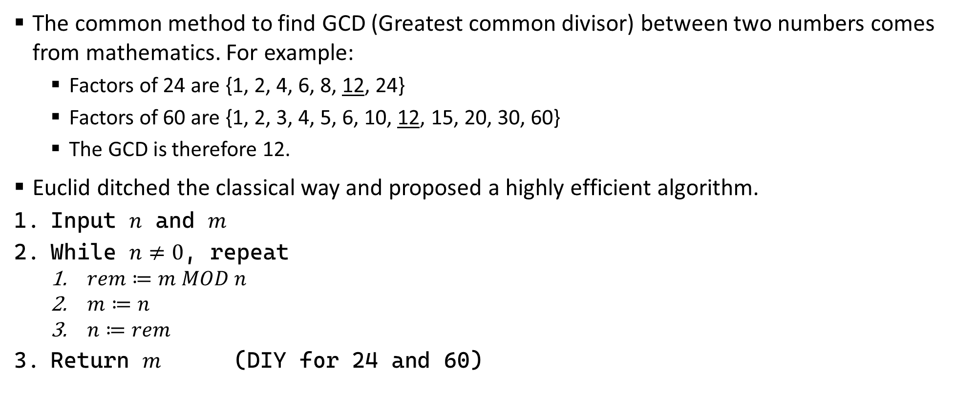
Sample 2
Euclid’s Genius
The common method to find GCD (Greatest common divisor) between two numbers comes from mathematics. For example:
Factors of 24 are {1, 2, 4, 6, 8, 12, 24}
Factors of 60 are {1, 2, 3, 4, 5, 6, 10, 12, 15, 20, 30, 60}
The GCD is therefore 12.
Euclid ditched the classical way and proposed a highly efficient algorithm.
Input $n$ and $m$
While $n≠0$, repeat
$rem≔m MOD n$
$m≔n$
$n≔rem$
Return $m$ (DIY for 24 and 60)

Slide 23
Sample 2
Space and Time Complexity
Space complexity means how much storage/memory is required to solve a given problem.
Space complexity is measured in computer storage units (bytes, etc.)
Time complexity means how much time is required to solve a given problem.
Time complexity is measured usually in seconds/minutes, however for simplicity, we often use the term “unit of time”.
Both are used to measure the efficiency of an algorithm. However, since memory is cheaper, we mainly focus on time complexity.

Slide 24
Sample 2
Exercise
An algorithm inputs CGPA of students in your class. Suppose that the algorithm take 1ms to compare two numbers, then what will be the worst time complexity of this algorithm if we ask it to find out highest CGPA in your class?

Slide 25
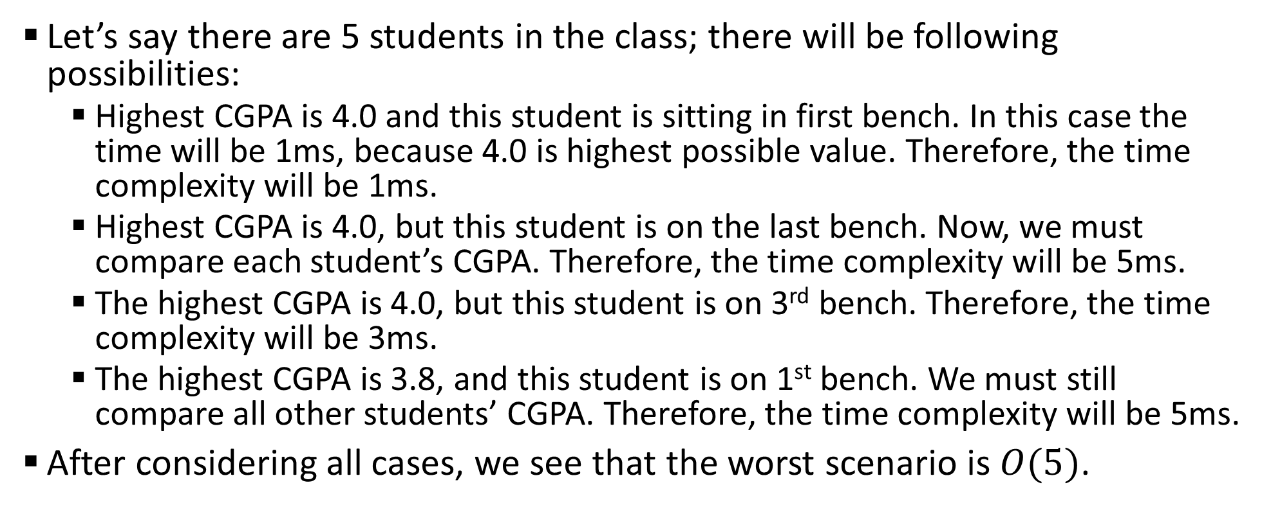
Sample 2
Exercise
Let’s say there are 5 students in the class; there will be following possibilities:
Highest CGPA is 4.0 and this student is sitting in first bench. In this case the time will be 1ms, because 4.0 is highest possible value. Therefore, the time complexity will be 1ms.
Highest CGPA is 4.0, but this student is on the last bench. Now, we must compare each student’s CGPA. Therefore, the time complexity will be 5ms.
The highest CGPA is 4.0, but this student is on 3rd bench. Therefore, the time complexity will be 3ms.
The highest CGPA is 3.8, and this student is on 1st bench. We must still compare all other students’ CGPA. Therefore, the time complexity will be 5ms.
After considering all cases, we see that the worst scenario is $O(5)$.

Slide 26
Sample 2
Real life Example
Unit conversion (ask someone who migrated to USA).
Conflict free scheduling (ask KIET’s admin staff).
Vacuum cleaning robot.
Quake III’s groundbreaking approximation method.

Slide 27
Sample 2
Assignment 1
Draw a circle.
Place two points to create a chord. Count the number of total segments.
Place 3rd point and connect it with the other two. Count again.
Place 4th point and connect all points with each other. Count again.
Place 5th point and repeat.
Can you guess the number of partitions if you added 6th point?
Verify your answer by adding 6th point.
Design an algorithm (any language, any notations) which inputs number of distinct points to plot on a circle and calculates the number of partitions formed when all points are connected with each other.

Slide 28



THANK YOU
Owais Hussain
+92 345-3174270
owais.hussain@kiet.edu.pk
https://www.researchgate.net/profile/Owais-Hussain-3

